Slide 1
Graphing Linear Equations: T-Charts

Slide 2
The Graph of an Equation in Two Variables
The graph of an equation in two variables is the graph of all ordered pair solutions to the equation.
Copyright (c) The McGraw-Hill Companies, Inc. Permission required for reproduction or display.
Slide 2

Slide 3
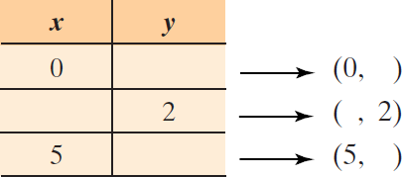
3
Graphing a Linear Equation in Two Variables
We will find three ordered pairs that are solutions to the equation. In the table, we have selected arbitrary (random) values for x or y and must complete the ordered pairs.
(continued)
Copyright (c) The McGraw-Hill Companies, Inc. Permission required for reproduction or display.
Slide 3

Slide 4
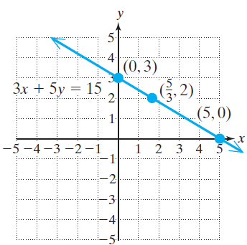
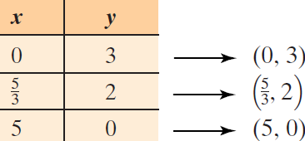
3
Graphing a Linear Equation in Two Variables
The completed list of ordered pairs is shown. To graph the equation, plot the three solutions and draw the line through the points. Arrows on the ends of the line indicate that points on the line extend infinitely in both
directions.
Copyright (c) The McGraw-Hill Companies, Inc. Permission required for reproduction or display.
Slide 4

Slide 5
x- and y-Intercepts
An x-intercept (a, 0) is a point where a graph intersects the x-axis.
A y-intercept (0, b) is a point where a graph intersects the y-axis.
(continued)
Copyright (c) The McGraw-Hill Companies, Inc. Permission required for reproduction or display.
Slide 5

Slide 6
Determining the x- and y-Intercepts from an Equation
Given an equation with x and y,
• Find the x-intercept(s) by substituting y = 0 into the equation and solving for x.
• Find the y-intercept(s) by substituting x = 0 into the equation and solving for y.
Copyright (c) The McGraw-Hill Companies, Inc. Permission required for reproduction or display.
Slide 6

Slide 7
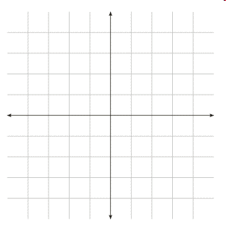
5
Finding the x- and y-Intercepts of a Line
Copyright (c) The McGraw-Hill Companies, Inc. Permission required for reproduction or display.
Slide 7

Slide 8
8
Graphing a Vertical Line
Graph the equation x = 6.
Copyright (c) The McGraw-Hill Companies, Inc. Permission required for reproduction or display.
Slide 8

Slide 9
9
Graphing a Horizontal Line
Copyright (c) The McGraw-Hill Companies, Inc. Permission required for reproduction or display.
Slide 9

Slide 10
Equations of Vertical and Horizontal Lines
1. A vertical line can be represented by an equation of the form, x = k, where k is a constant.
2. A horizontal line can be represented by an equation of the form, y = k, where k is a constant.
Copyright (c) The McGraw-Hill Companies, Inc. Permission required for reproduction or display.
Slide 10

