Slide 1
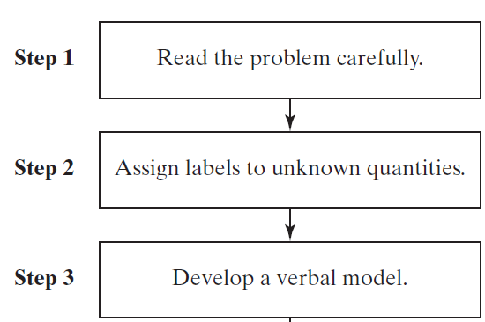
1.5
Applications of Linear Equations in One Variable
1.
Introduction to Problem Solving
(continued)
Copyright (c) The McGraw-Hill Companies, Inc. Permission required for reproduction or display.
Slide 1

Slide 2
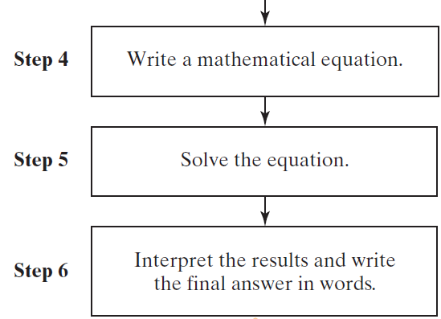
1.5
Applications of Linear Equations in One Variable
1.
Introduction to Problem Solving
Copyright (c) The McGraw-Hill Companies, Inc. Permission required for reproduction or display.
Slide 2

Slide 3
1
Translating and Solving a Linear Equation
The sum of two numbers is 39. One number is 3 less than twice the other. What are the numbers?
Copyright (c) The McGraw-Hill Companies, Inc. Permission required for reproduction or display.
Slide 3

Slide 4
2
Solving a Linear Equation Involving
Consecutive Integers
The sum of two consecutive odd integers is 172. Find the integers.
Copyright (c) The McGraw-Hill Companies, Inc. Permission required for reproduction or display.
Slide 4

Slide 5
1.5
Applications of Linear Equations in One Variable
3.
Applications Involving Percents and Rates
The following models are used to compute sales tax, commission, and simple interest. In each case the value is found by multiplying the base by the percentage.
Sales tax = (cost of merchandise)(tax rate)
Commission = (dollars in sales)(commission rate)
Simple interest = (principal)(annual interest rate)(time in years)
I = Prt
Copyright (c) The McGraw-Hill Companies, Inc. Permission required for reproduction or display.
Slide 5

Slide 6
3
Solving a Percent Application
A woman invests $5000 in an account that earns % simple interest. If the money is invested for 3 years (yr), how much money is in the account at the end of the 3-yr period?
Copyright (c) The McGraw-Hill Companies, Inc. Permission required for reproduction or display.
Slide 6

Slide 7
4
Solving a Percent Increase Application
A college bookstore uses a standard markup of 40% on all books purchased wholesale from the publisher. If the bookstore sells a calculus book for $119.00, what was the original wholesale cost?
Copyright (c) The McGraw-Hill Companies, Inc. Permission required for reproduction or display.
Slide 7

